Slide 1

CS 590M Fall 2001: Security Issues in Data Mining
Chris Clifton
Tuesdays and Thursdays, 9-10:15
Heavilon Hall 123

Slide 2
Course Goals:
Knowledge
At the end of this course, you will:
Have a basic understanding of the technology involved in Data Mining
Know how data mining impacts information security
Understand leading-edge research on data mining and security

Slide 3
Course Goals:
Skills
At the end of this course, you will:
Be able to understand new technology through reading the research literature
Have given conference-style presentations on difficult research topics
Have written journal-style critical reviews of research papers

Slide 4
Course Topics
Data Mining (as necessary)
  What is it?
  How does it work?
Research in the use of Data Mining to improve security
Research in the security problems posed by the availability of Data Mining technology

Slide 5
Process
Initial phase of course: Data Mining background
Lectures, handouts, suggested reading
Length/material to be determined by what you already know
Expect a quiz at the end of this phase

Slide 6
Process
Phase 2: Student Presentations
Two paper presentations per class
  Student presenting will read paper and prepare presentation materials
  You must prepare materials yourself – no fair using material obtained from the authors
Any week you do not present, you will do a journal quality review of one of the papers being presented that week
  You may request a papers to review/present, I will do final assignment

Slide 7
Evaluation/Grading
Evaluation will be a subjective process, however it will be based primarily on your understanding of the material as evidenced in:
Your presentations
Your written reviews
Your contribution to classroom discussions
Post phase-1 quiz

Slide 8
Policy on Academic Integrity
Basic idea: You are learning to do Original Research
  Work you do for the class should be original (yours)
  Don’t borrow authors slides for presentations, even if they are available.
  Copying images/graphs okay where necessary
More details on course web site: http://www.cs.purdue.edu/homes/clifton/cs590m
When in doubt, ASK!

Slide 9
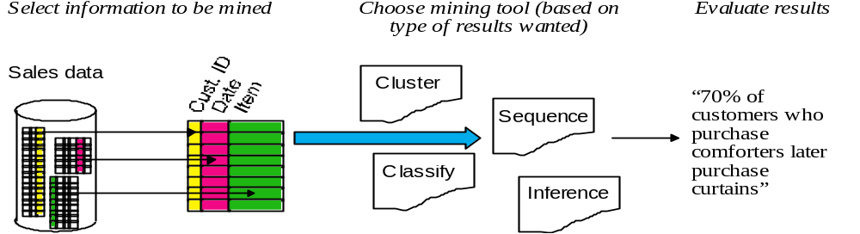
What is Data Mining?
Searching through large amounts of data for correlations, sequences, and trends.
Current “driving applications” in sales (targeted marketing, inventory) and finance (stock picking)

Slide 10

Knowledge Discovery in Databases: Process
Interpretation/
Evaluation
Knowledge
Data Mining
Preprocessing
Patterns
Selection
Preprocessed
Data
Data
Target
Data
adapted from:
U. Fayyad, et al. (1995), “From Knowledge Discovery to Data Mining: An Overview,” Advanced in Knowledge Discovery and Data Mining, U. Fayyad et al. (Eds.), AAAI/MIT Press
See also: http://www.crisp-dm.org
Notes:
Mine for:
Selection
Aggregation
Abstraction
Visualization
Transformation/Conversion
Statistical Analysis
“Cleaning”

Slide 11
What is Data Mining?
History
Knowledge Discovery in Databases workshops started ‘89
  Now a conference under the auspices of ACM SIGKDD
  IEEE conference series starting 2001
Key founders / technology contributers:
  Usama Fayyad, JPL (then Microsoft, now has his own company, Digimine)
  Gregory Piatetsky-Shapiro (then GTE, now his own data mining consulting company, Knowledge Stream Partners)
  Rakesh Agrawal (IBM Research)
The term “data mining” has been around since at least 1983 -- as a pejorative term in the statistics community

Slide 12
What Can Data Mining Do?
Cluster
Classify
  Categorical, Regression
Summarize
  Summary statistics, Summary rules
Link Analysis / Model Dependencies
  Association rules
Sequence analysis
  Time-series analysis, Sequential associations
Detect Deviations

Slide 13
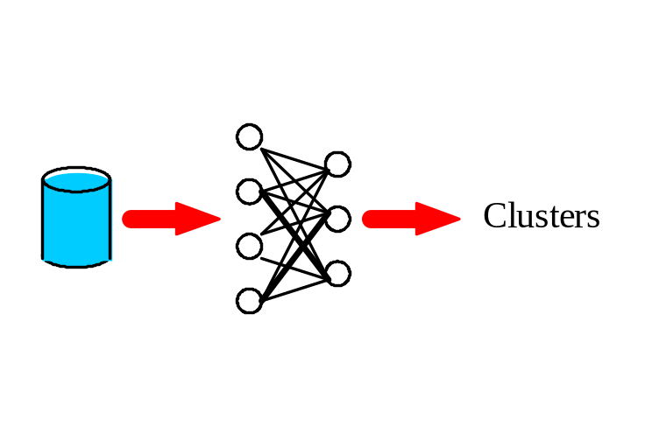
Clustering
Find groups of similar data items
Statistical techniques require definition of “distance” (e.g. between travel profiles), conceptual techniques use background concepts and logical descriptions
Uses:
Demographic analysis
Technologies:
Self-Organizing Maps
Probability Densities
Conceptual Clustering
“Group people with similar travel profiles”
  George, Patricia
  Jeff, Evelyn, Chris
  Rob
Top Stories clustering

Slide 14
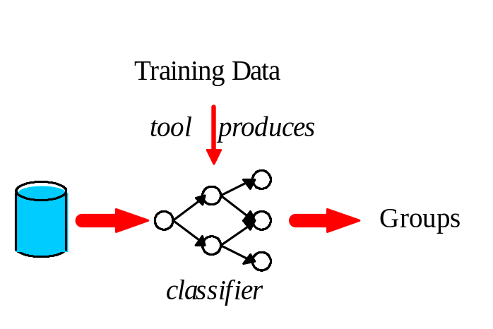
Classification
Find ways to separate data items into pre-defined groups
  We know X and Y belong together, find other things in same group
Requires “training data”: Data items where group is known
Uses:
Profiling
Technologies:
Generate decision trees (results are human understandable)
Neural Nets
“Route documents to most likely interested parties”
  English or non-english?
  Domestic or Foreign?

Slide 15
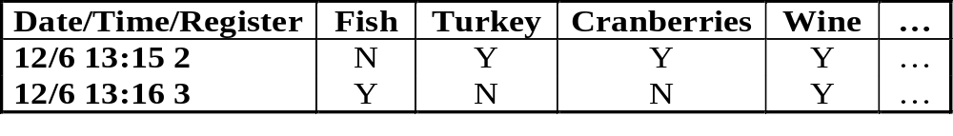
Association Rules
Identify dependencies in the data:
  X makes Y likely
Indicate significance of each dependency
Bayesian methods
Uses:
Targeted marketing
Technologies:
AIS, SETM, Hugin, TETRAD II
“Find groups of items commonly purchased together”
  People who purchase fish are extraordinarily likely to purchase wine
  People who purchase Turkey are extraordinarily likely to purchase cranberries

Slide 16
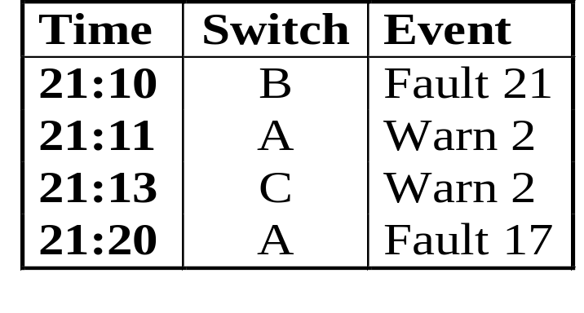
Sequential Associations
Find event sequences that are unusually likely
Requires “training” event list, known “interesting” events
Must be robust in the face of additional “noise” events
Uses:
Failure analysis and prediction
Technologies:
Dynamic programming (Dynamic time warping)
“Custom” algorithms
“Find common sequences of warnings/faults within 10 minute periods”
  Warn 2 on Switch C preceded by Fault 21 on Switch B
  Fault 17 on any switch preceded by Warn 2 on any switch

Slide 17
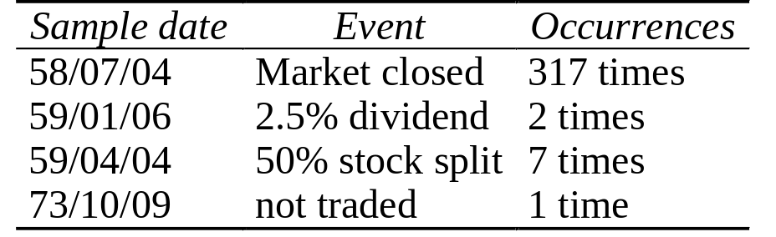
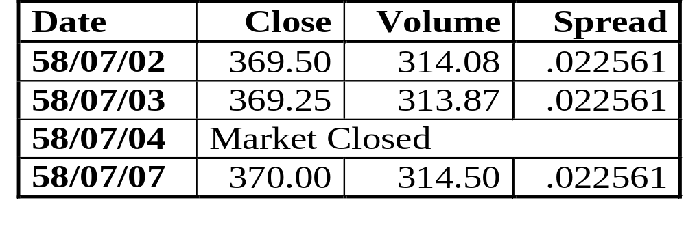
Deviation Detection
Find unexpected values, outliers
Uses:
Failure analysis
Anomaly discovery for analysis
Technologies:
clustering/classification methods
Statistical techniques
visualization
“Find unusual occurrences in IBM stock prices”

Slide 18
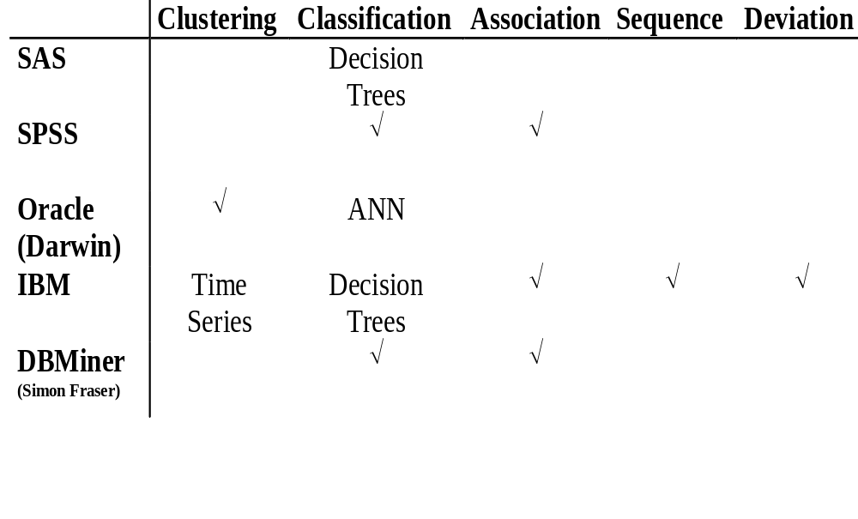
Large-scale Endeavors
Products
Research
Notes:
12

Slide 19
War Stories:
Warehouse Product Allocation
The second project, identified as "Warehouse Product Allocation," was also initiated in late 1995 by RS Components' IS and Operations Departments. In addition to their warehouse in Corby, the company was in the process of opening another 500,000-square-foot site in the Midlands region of the U.K. To efficiently ship product from these two locations, it was essential that RS Components know in advance what products should be allocated to which warehouse. For this project, the team used IBM Intelligent Miner and additional optimization logic to split RS Components' product sets between these two sites so that the number of partial orders and split shipments would be minimized.
Parker says that the Warehouse Product Allocation project has directly contributed to a significant savings in the number of parcels shipped, and therefore in shipping costs. In addition, he says that the Opportunity Selling project not only increased the level of service, but also made it easier to provide new subsidiaries with the value-added knowledge that enables them to quickly ramp-up sales.
"By using the data mining tools and some additional optimization logic, IBM helped us produce a solution which heavily outperformed the best solution that we could have arrived at by conventional techniques," said Parker. "The IBM group tracked historical order data and conclusively demonstrated that data mining produced increased revenue that will give us a return on investment 10 times greater than the amount we spent on the first project."
http://direct.boulder.ibm.com/dss/customer/rscomp.html

Slide 20
War Stories:
Inventory Forecasting
American Entertainment Company
Forecasting demand for inventory is a central problem for any distributor. Ship too much and the distributor incurs the cost of restocking unsold products; ship too little and sales opportunities are lost.
IBM Data Mining Solutions assisted this customer by providing an inventory forecasting model, using segmentation and predictive modeling. This new model has proven to be considerably more accurate than any prior forecasting model.
More war stories (many humorous) starting with slide 21 of:
http://robotics.stanford.edu/~ronnyk/chasm.pdf

Slide 21
Data Mining as a Threat to Security
Data mining gives us “facts” that are not obvious to human analysts of the data
Enables inspection and analysis of huge amounts of data
Possible threats:
  Predict information about classified work from correlation with unclassified work (e.g. budgets, staffing)
  Detect “hidden” information based on “conspicuous” lack of information
  Mining “Open Source” data to determine predictive events (e.g., Pizza deliveries to the Pentagon)
It isn’t the data we want to protect, but correlations among data items
Published in Chris Clifton and Don Marks, “Security and Privacy Implications of Data Mining”, Proceedings of the 1996 ACM SIGMOD Workshop on Research Issues in Data Mining and Knowledge Discovery
Notes:
Problem is that we may not know what may be learned from mining
Can’t “Classify everything”; as some is open source or may have large benefits to being accessible
This is the opposite of statistical queries – we are concerned about preventing generalities from specifics, rather then specifics from generalities – but conceptually similar.
Not the same as induction – data mining finds “rules” that are generally true (high confidence and support), but not necessarily exact.

Slide 22
Background – Inference Problem
MLS database – “high” and “low” data
  Problem if we can infer “high” data from “low” data
  Progress has been made (Morgenstern, Marks, ...)
Problem: What if the inference isn’t “strict”?
  “Default inference” problems – Birds fly, an Ostrich is a bird, so Ostriches fly – not true, so we can’t infer birds fly (and we don’t prevent such an inference)
  But “birds fly” is useful, even if not strictly true
  Only limited work in detecting/preventing “imprecise” inferences (Rath, Jones, Hale, Shenoi)
Data mining specializes in finding imprecise inferences

Slide 23
Data mining – Inference from Large Data
Data mining gives us probabilistic “inferences”:
  25% of group X is Y, but only 2% of population is Y.
Key to data mining: Don’t need to pre-specify X and Y.
  Define total population
  Define parameters that can be used to create group X
  Define parameters that can be used to create group Y
  Note the combinatorial explosion in the number of possible groups: if three parameters used to create group X, possible n3 groups
Data mining tool determines groups X and Y where “inference” is unusually likely
Existing inference prevention based on guaranteed truth of inference, but is this good enough?

Slide 24
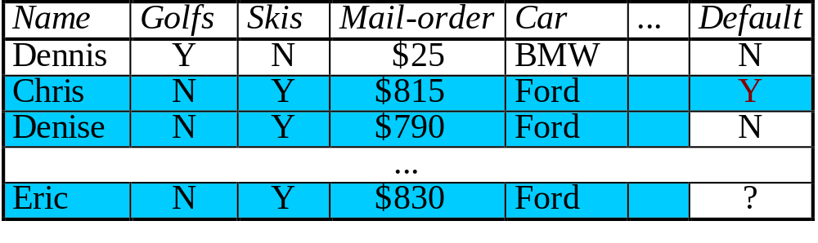
Motivating Example: Mortgage Application
Idea: Mortgage company buys market research data to develop profile of people likely to default
  Marketing data available
  Mortgage companies have history of current client defaults
Problem: If 20% of profile defaults, it may make business sense to reject all – but is it fair to the 80% that wouldn’t?
Information Provider doesn’t want this done (potential public backlash, e.g. Lotus)

Slide 25
Goal – Technical Solution
We want to protect the information provider.
Prevent others from finding any meaningful correlations
  Must still provide access to individual data elements (e.g. phone book)
Prevent specific correlations (or classes of correlations)
  Preserve ability to mine in desired fashion (e.g. targeted marketing, inventory prediction)

Slide 26
What Can We Do?
Prevent useful results from mining
  Algorithms only find “facts” with sufficient confidence and support
  Limit data access to ensure low confidence and support
  Extra data (“cover stories”) to give “false” results with high confidence and support
Exploit weaknesses in mining algorithms
  Performance “blowups” under certain conditions
  Alter data to prevent exact matches
Example: Extra digit at end of telephone number
Remove information providing unwanted correlations
  Strip identifiers
  Group identifiers (e.g. census blocks, not addresses)
“You mine the data, I’ll send the mailings”

Slide 27
What We Have Learned So Far:
Qualitative Results
Avoid unnecessary groupings of data
  Ranges of instances can give information
    Department encodes center, division
    Employee number encodes hire date
  Knowing the meaning of a grouping is not necessary; the existence of a meaningful grouping allows us to mine
  Moral: Assign “id numbers” randomly (still serve to identify)
Providing only samples of data can lower confidence in mining results
  Key: Provable limits for validity of mining results given a sample

Slide 28
Data Mining to Handle Security Problems
Data mining tools can be used to examine audit data and flag abnormal behavior
Some work in Intrusion detection
  e.g., Neural networks to detect abnormal patterns
    SRI work on IDES
    Harris Corporation work
Tools are being examined as a means to determine abnormal patterns and also to determine the type of problem
  Classification techniques
Can draw heavily on Fraud detection
  Credit cards, calling cards, etc.
  Work by SRA Corporation

Slide 29
Data Mining to Improve Security
Intrusion Detection
  Relies on “training data”
  We’ll go into detail on this area (lots of new work)
User profiling (what is normal behavior for a user)
  Lots of work in the telecommunications industry (caller fraud)
  Work is happening in computer security community
    Various work in “command sequence” profiles

